Slide 1
Honeypot Project Findings
By Minh Le

Slide 2
！Notes
Goal: Attract and observe common internet attack traffic (scanning, brute-force, probing) in a controlled honeypot environment.
Time window: Jan 1st – Jan 9th (UTC time).
GeoIP caveat: GeoIP is context only and may be skewed by VPNs/proxies, carrier NAT, or IP reassignment.
Network-layer (VPC Flow Logs):
Attempts = count of ACCEPTed inbound flows to a destination port (scoped to the honeypot ENI/private IP).
ActiveMinutes = number of distinct 1-minute bins with ≥1 such flow for a given source IP.
Host-layer (CloudWatch/sshd):
Attempts = count of sshd authentication failure events (e.g., invalid user / failed password) for a given source IP.

Slide 3
Honeypot Setup & Telemetry
Architecture: AWS hosts the honeypot and generates telemetry; Microsoft Sentinel (Azure) ingests the logs for correlation, querying, and visualization.
Exposed services (TCP): Internet-facing ports 22 (SSH), 23 (Telnet), 80 (HTTP), 445 (SMB), 3389 (RDP), 1433 (MSSQL) to simulate a misconfigured host.
Data sources: VPC Flow Logs (network metadata), CloudWatch logs (service/host events), and GuardDuty findings for additional threat signals.
Filtering & normalization: Restricted to the honeypot ENI and private IP, filtered to relevant inbound records, normalized source IP using coalesce(PktSrcAddr, SrcAddr), and excluded private RFC1918 sources via ipv4_is_private()

Slide 4
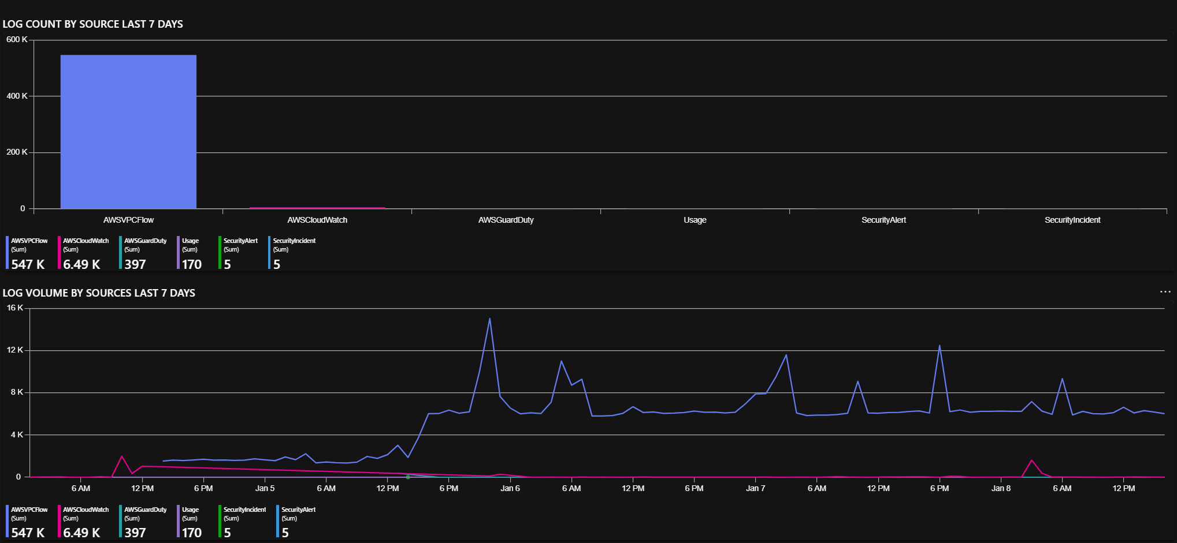
VPC Flow Logs overwhelmingly dominate ingestion over the observed period, with noticeable surges around midnight to early morning UTC time.

Slide 5
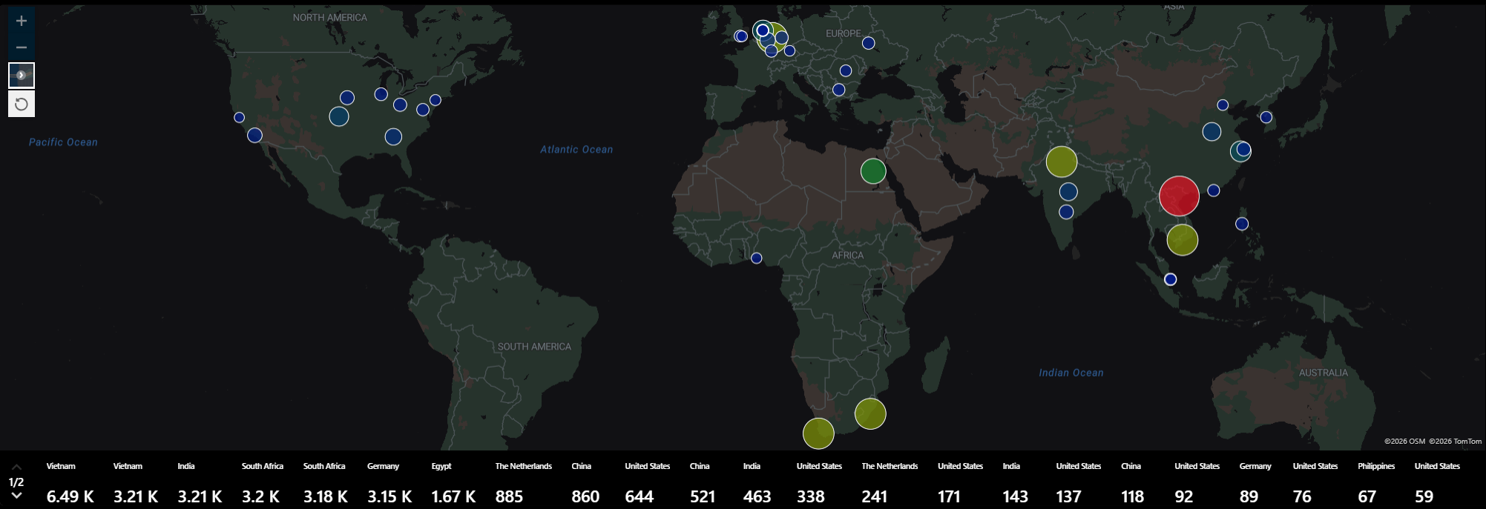
TOP 50 GLOBAL NETWORK TRAFFIC
between
January 1st and January 8th, 2026
Traffic originates from a wide geographic spread, with notable concentrations in Asia, Europe, and North America.

Slide 6
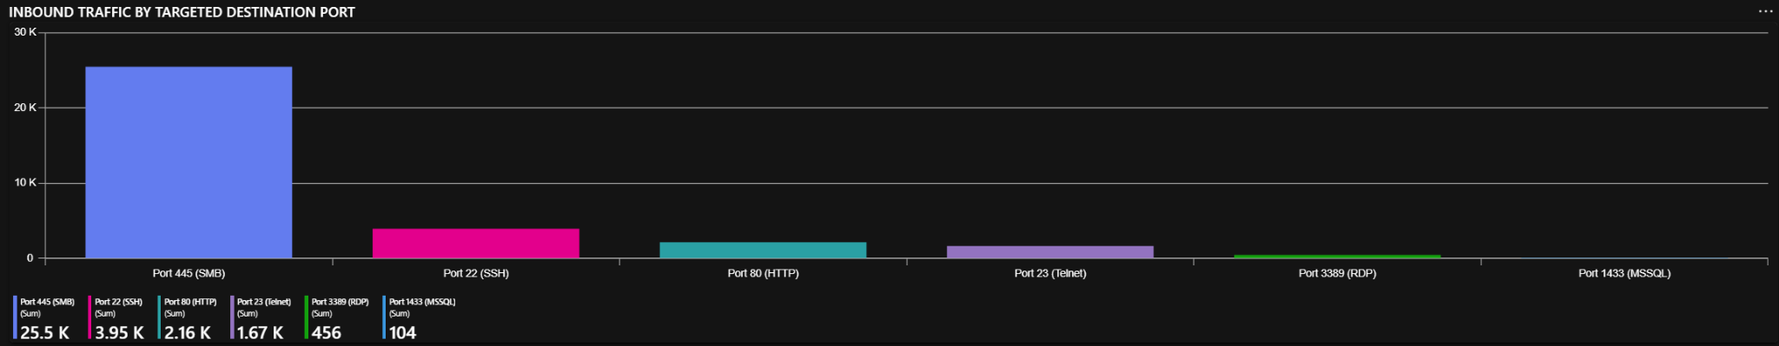
Observed inbound traffic was dominated by 445/22/80 (≈94% of events). Telnet (23) showed secondary background scanning (≈5%), while RDP (3389) and MSSQL (1433) were negligible (≈1.7% combined) during the time window.

Slide 7
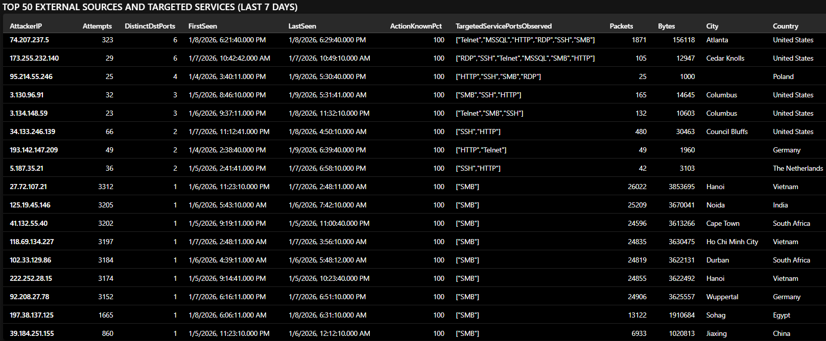
Predominant activity recorded from VPC Flow logs was broad internet scanning and opportunistic probing, not targeted intrusion; most sources showed short burst patterns consistent with automated tooling.
The honeypot saw mostly reconnaissance‑level activity across SSH, SMB, and HTTP—SSH dominated with concentrated authentication failures, SMB showed periodic scanning waves, and HTTP lacked application‑layer detail—yielding no confirmed compromise indicators but leaving conclusions constrained by logging gaps and GeoIP limitations.
Key outcome: the pipeline and workbook successfully surfaced attacker patterns (top sources, time-series bursts, geographic distribution) and identified concrete improvements for future iterations (restore full app logging, tighten metrics/definitions, add port-wide coverage and correlation).

Slide 8
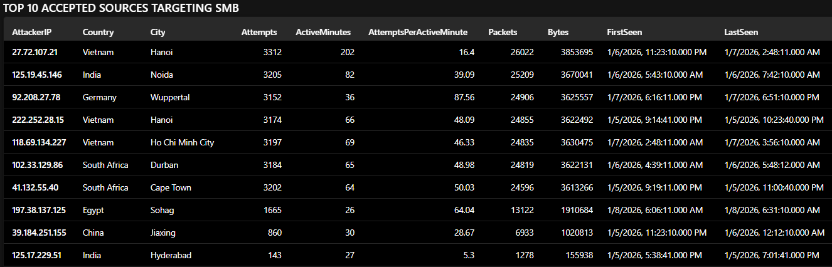
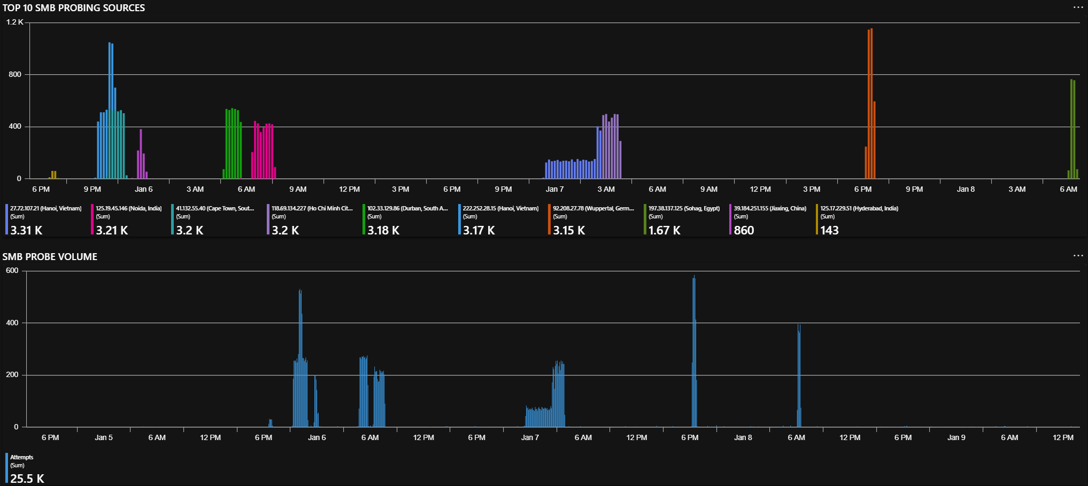
Network layer SMB (VPC)
~25.5K accepted TCP/445 flow records to the honeypot, occurring in bursty spikes rather than steady background traffic (consistent with automated scanning/probing waves).
Top sources and rate vs persistence
Highest volume (most persistent): 27.72.107.21 (Hanoi, Vietnam) generated 3,312 attempts across 202 active minutes (~16.4 attempts/min) over ~3.4 hours (sustained activity at moderate rate)
Highest rate burst: 92.208.27.78 (Wuppertal, Germany) generated 3,152 attempts across 36 active minutes (~87.6 attempts/min), consistent with a short high-rate probing burst.
Notable high-rate source (previously highlighted): 197.38.137.125 (Sohag, Egypt) generated 1,665 attempts across 26 active minutes (~64.0 attempts/min), also indicative of automated probing

Slide 9
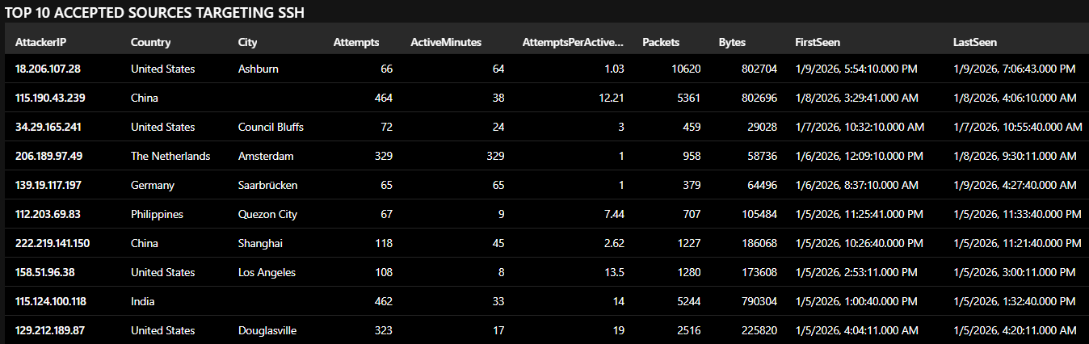
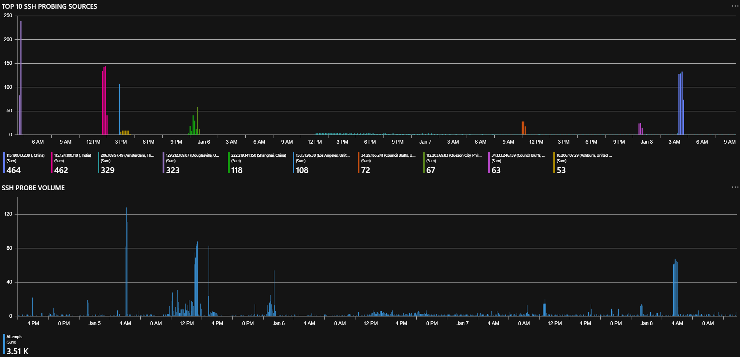
Network layer SSH (VPC)
Top contributors are
115.190.43.239 (China, 464)
115.124.100.118 (India, 462)
They are the two largest single sources (combined ~26% of total)
High-rate connection bursts to TCP/22:
US: 129.212.189.87
(323 / 17 ≈ 19 attempt/min)
India 115.124.100.118
(462 / 33 ≈ 14 attempt/min)
US: 158.51.96.38
(108 / 8 ≈ 13.5 attempt/min)
China: 115.190.43.239
(464 / 38 ≈ 12.2 attempt/min)
Low-and-slow persistence (continuous probing) observed:
Netherlands: 206.189.97.49
( 329 / 329 min ≈ 1 attempt/min)
Spanning many days

Slide 10
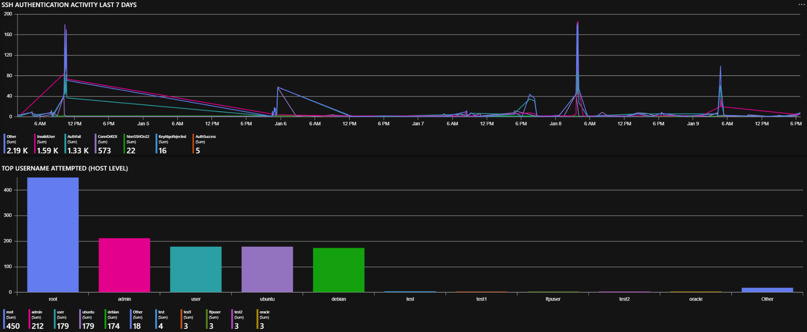
Host Layer SSH (CloudWatch / sshd auth logs)
Auth failures dominated; only a small number of successful logins were observed and were associated with expected administrative access.
Attackers targeted default Linux accounts (root, admin, user, ubuntu, debian), consistent with broad credential‑stuffing playbooks rather than targeted intrusion.
Authentication failures dominated; a small number of successful logins were observed and were consistent with expected administrative access. No confirmed compromise indicators were identified in the available telemetry.

Slide 11
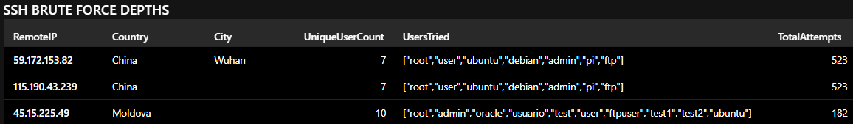
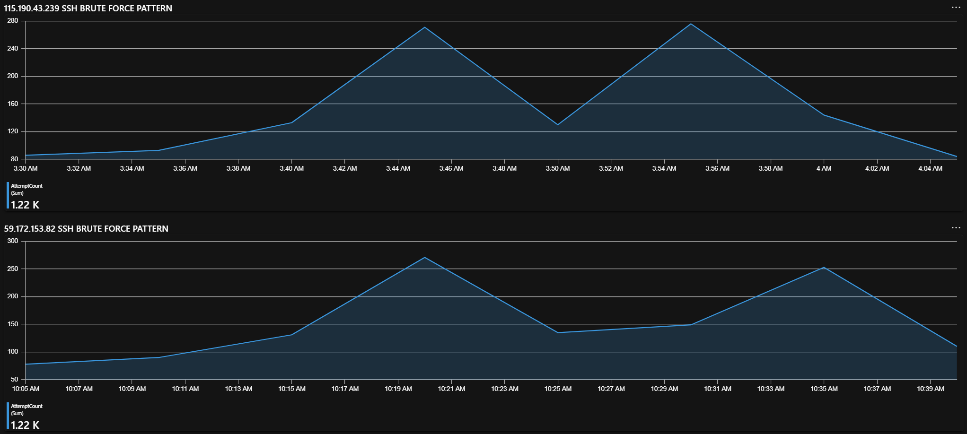
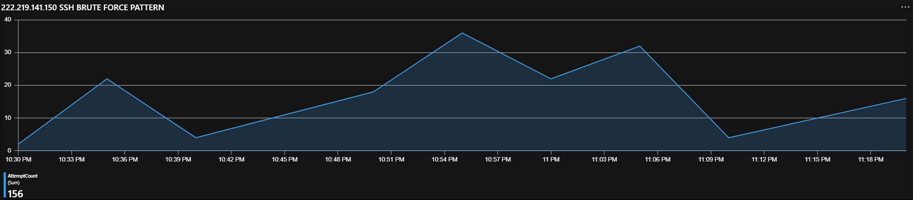
Host Layer SSH (CloudWatch / sshd auth logs)
CloudWatch SSH logs show concentrated brute-force activity from three interesting main source:
59.172.153.82 (Wuhan) and 115.190.43.239 with 523 attempts each. Both are the highest-volume IPs and targeted the same seven common usernames (root, admin, ubuntu, debian, pi, ftp, user)
Exhibit bursty time-series patterns, which is consistent with automated dictionary/brute-force tooling and may indicate a shared campaign or tool configuration (though IPs alone cannot confirm a single actor).
45.15.225.49 (Moldova): 182 total attempts, 10 unique usernames tried: root, admin, oracle, usuario, test, user, ftpuser, test1, test2, ubuntu
Shows a different username strategy (more varied and including localized/testing-style names), suggesting a different tooling profile or operator configuration.

Slide 12
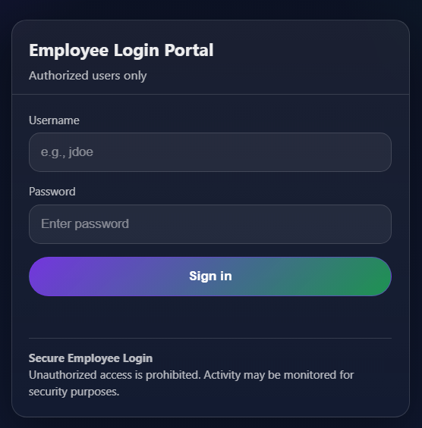
To increase engagement to the honeypot and generate richer HTTP telemetry, a realistic fake employee login page was deployed on port 80.
Components added:
index.html – Honeypot landing page with link to login portal
login.html – Fully styled employee login form (username + password)
/login POST handler – Static endpoint simulating failed authentication
Purpose:
Attract credential‑stuffing bots
Trigger POST requests for Sentinel analysis
Capture attacker behavior beyond simple port scans
Enrich CloudWatch → S3 → Sentinel ingestion pipeline

Slide 13
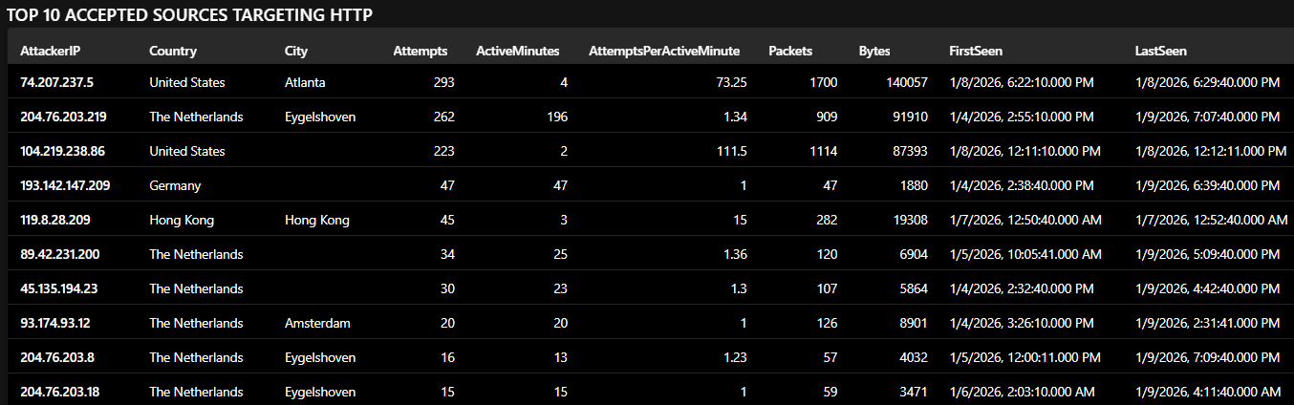
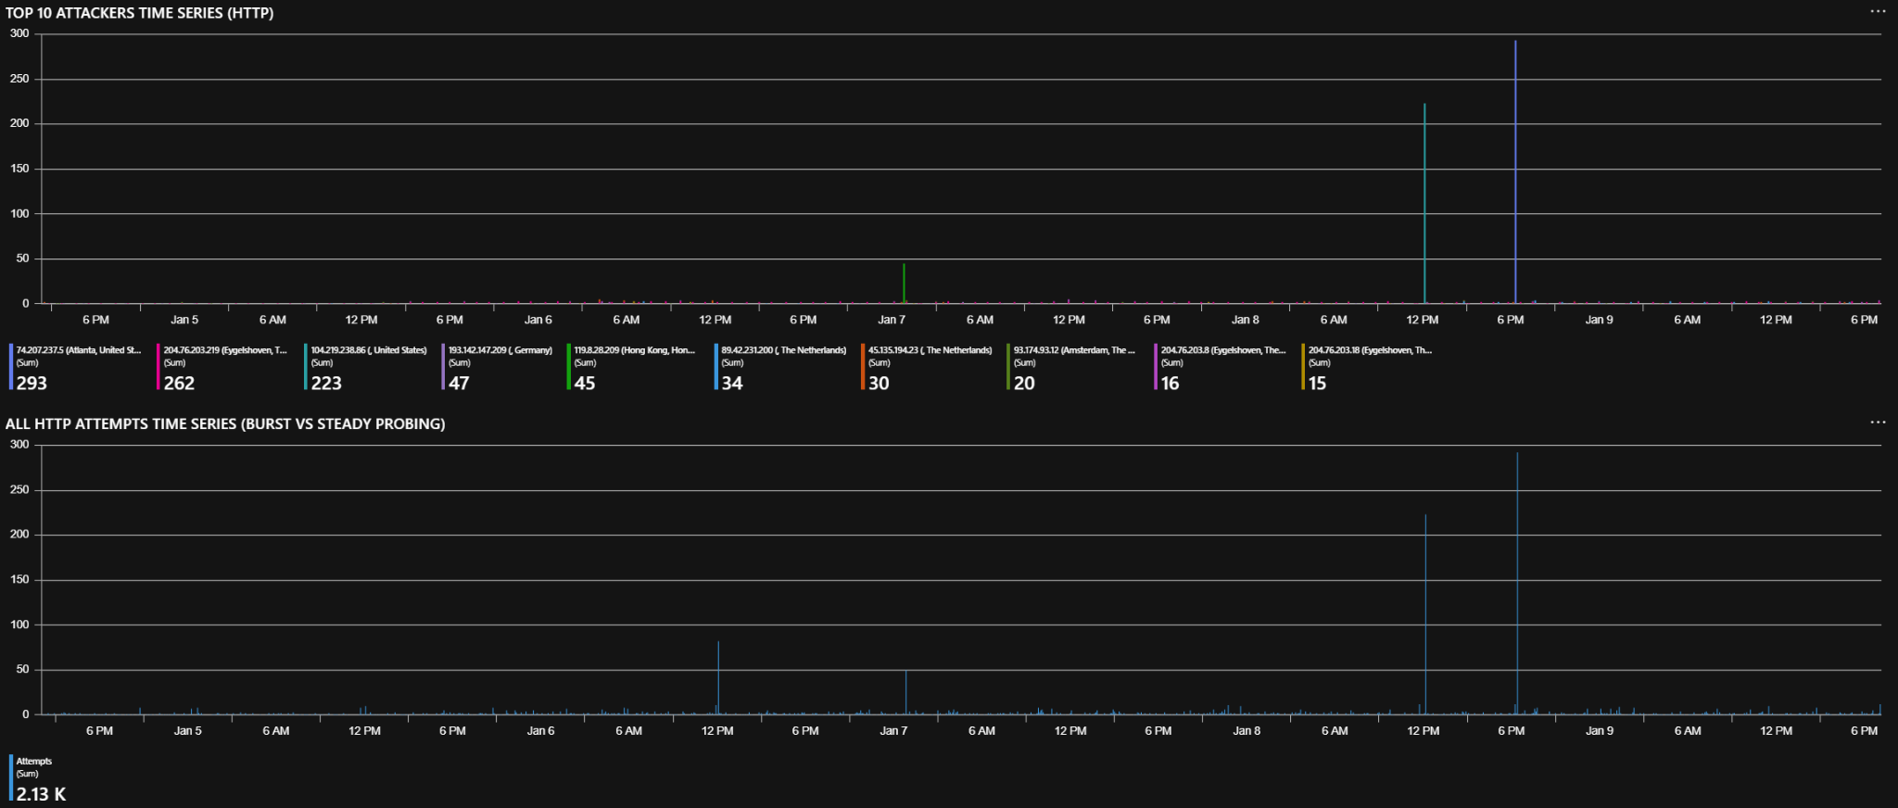
Network layer HTTP (VPC)
~2.13K accepted TCP/80 flow records, showing a mix of short high‑rate bursts and long‑duration low‑rate probing (typical of automated HTTP reconnaissance).
Top sources and rate vs persistence
Highest rate burst:
74.207.237.5 (Atlanta, United States) generated 293 attempts across 4 active minutes
(~73.25 attempts/min), indicating a fast, short‑duration scanning burst.
Second high‑rate burst:
104.219.238.86 (United States) generated 223 attempts across 2 active minutes
(~111.5 attempts/min), consistent with extremely rapid probing.
Most persistent:
204.76.203.219 (Eygelshoven, Netherlands) generated 262 attempts across 196 active minutes
(~1.34 attempts/min), representing slow, long‑duration reconnaissance.

Slide 14
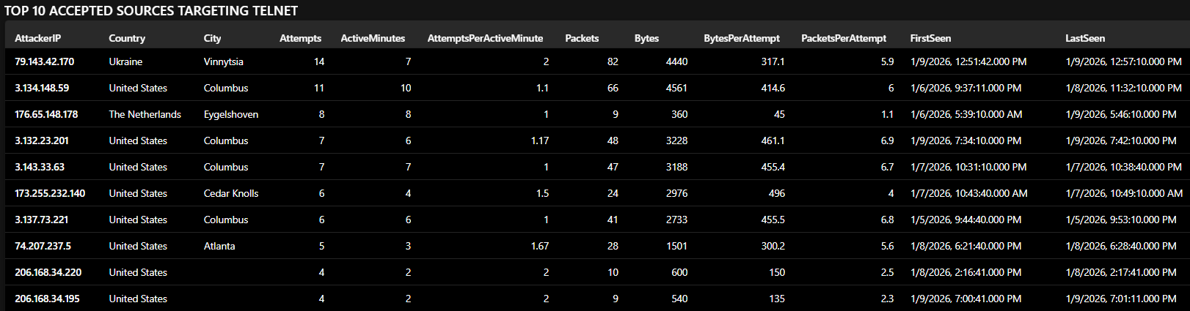
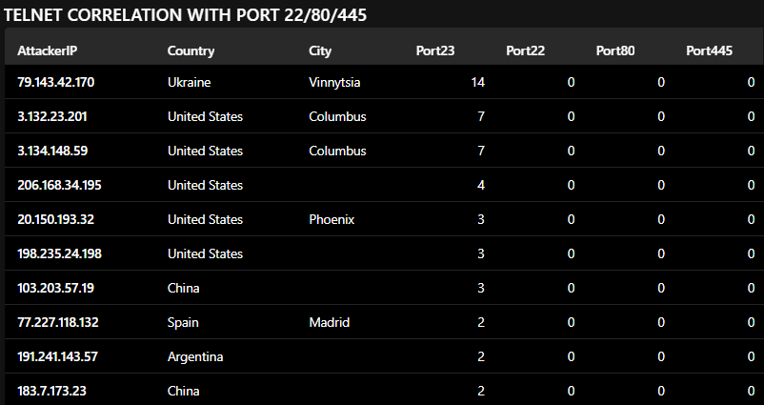
Network layer TELNET (VPC)
Telnet (23) activity appeared as low-volume probing. Top Telnet sources did not overlap with SSH/HTTP/SMB sources in the same window (based on flow telemetry)
No overlap found with top sources targeted SSH/HTTP/SMB, consistent with background automated internet scanning (flow-level telemetry; no Telnet service hosted).

Slide 15
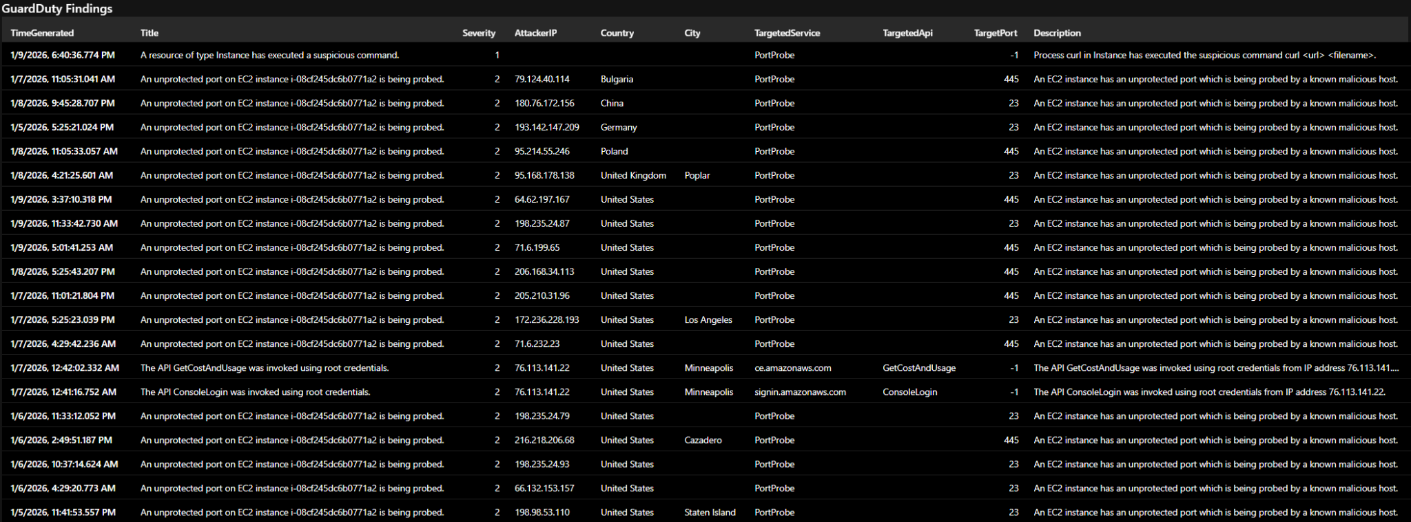
Source IPs geolocated primarily to the United States, with additional activity from Europe and Asia.
Findings were primarily PortProbe events against exposed services (notably TCP/445 and TCP/23), consistent with broad internet-wide reconnaissance.
GuardDuty reports the observed source IP, but geolocation can reflect VPNs, carrier/NAT egress, and cloud hosting; “US-based” should be treated as IP-geolocation context, not attribution.
Benign (self-generated): ‘Suspicious command’ and ‘GetCostAndUsage invoked using root credentials’ were triggered by my own administrative actions in the EC2/Console environment (not external attacker activity).

Slide 16
Some challenges I encountered
AWS CloudWatch ingestion pipeline instability:
CloudWatch Agent repeatedly overwrote the TOML config
Browser‑based editing corrupted the file
Result: Nginx HTTP logs never ingested, no application‑layer HTTP telemetry captured, only VPC Flow Logs and SSH logs
My takes:
Validate log ingestion early
Cloud logging pipelines can fail silently
Crafting least‑privilege IAM policies for CloudWatch, S3, SQS, and EC2
Slowed down pipeline setup and troubleshooting
AWS services are sensitive to incorrect IAM scopes
Hard to balance functionality with security best practices
My takes:
Document required actions for each service early
IAM policy design is a core skill in cloud security, not an afterthought
Start with minimal permissions and expand only when errors appear

Slide 17
Final thoughts
Observed activity was dominated by internet-wide reconnaissance and automated probing, with network-layer connection attempts concentrated on SMB (445) and SSH (22), plus secondary HTTP (80) and Telnet (23)
SSH telemetry (host logs) showed repeated authentication failures from a small set of sources, with both burst and persistent patterns consistent with commodity brute-force behavior.
Network-layer SMB/Telnet activity primarily reflected connection-level scanning patterns; Telnet had low-volume probing and did not correlate with top SSH/SMB/HTTP sources in the time window.
No confirmed compromise indicators were observed in collected telemetry.

